Slide 1

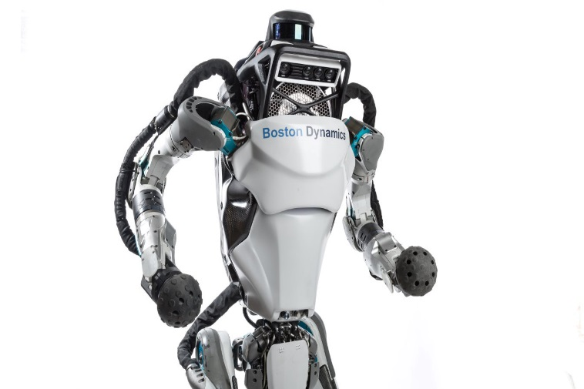
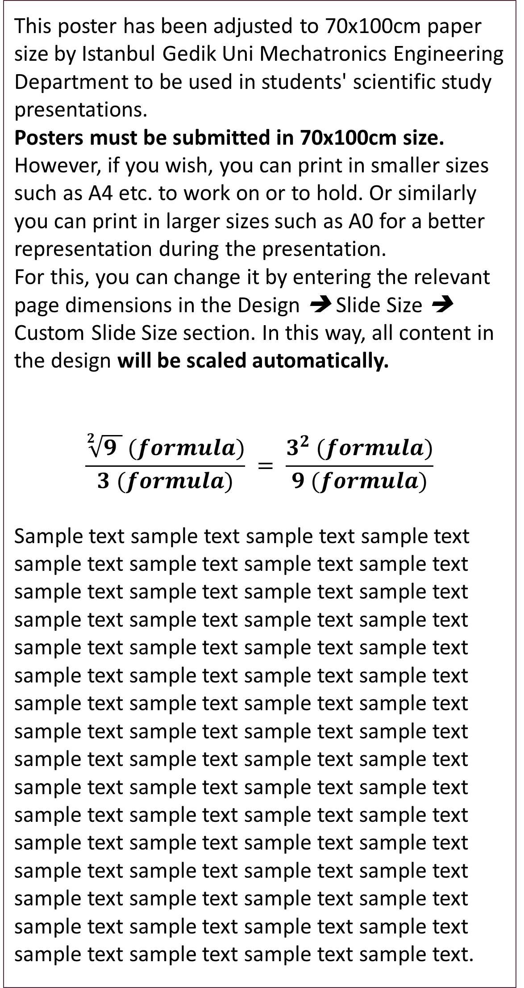
Thesis / Project Title
Replace With Your Own Title (Calibri-65pt)
Author1 Name Surname, 123456; Author2 Name Surname, 123456; …
(Calibri-40pt)
Abstract
Methods and Materials
Click here to add your Abstract text. You can copy and paste from your thesis.
This text box will automatically resize according to your text.
This text is Calibri 25pt and is easily readable up to 1.5 meters on a 70x100 poster.
Zoom up to 100% to preview how it will look on your printed poster.
Sample text sample text sample text sample text sample text sample text sample text sample text sample text sample text sample text sample text sample text sample text sample text sample text sample text sample text sample text sample text sample text sample text sample text sample text sample text sample text sample text sample text sample text sample text.
Click here to add your Methods and Materials text. You can copy and paste from your thesis.
This text box will automatically resize according to your text.
This text is Calibri 25pt and is easily readable up to 1.5 meters on a 70x100 poster.
Zoom up to 100% to preview how it will look on your printed poster.
Sample text sample text sample text sample text sample text sample text sample text sample text sample text sample text sample text sample text sample text sample text sample text sample text sample text sample text sample text sample text sample text sample text sample text sample text sample text sample text sample text.
Figure 3. Chart name. 20pt Calibri.
Introduction and purpose
Results
Discussion
This poster has been adjusted to 70x100cm paper size by Istanbul Gedik Uni Mechatronics Engineering Department to be used in students' scientific study presentations.
Posters must be submitted in 70x100cm size.
However, if you wish, you can print in smaller sizes such as A4 etc. to work on or to hold. Or similarly you can print in larger sizes such as A0 for a better representation during the presentation.
For this, you can change it by entering the relevant page dimensions in the Design ➔ Slide Size ➔ Custom Slide Size section. In this way, all content in the design will be scaled automatically.
$$\frac{\sqrt[2]{9 } (formula)}{3 (formula)} = \frac{3^{2} (formula)}{9 (formula)}$$
Sample text sample text sample text sample text sample text sample text sample text sample text sample text sample text sample text sample text sample text sample text sample text sample text sample text sample text sample text sample text sample text sample text sample text sample text sample text sample text sample text sample text sample text sample text sample text sample text sample text sample text sample text sample text sample text sample text sample text sample text sample text sample text sample text sample text sample text sample text sample text sample text sample text sample text sample text sample text sample text sample text sample text sample text sample text sample text sample text sample text sample text sample text sample text sample text.
Click here to add your results text. You can copy and paste from your thesis.
This text box will automatically resize according to your text.
This text is Calibri 25pt and is easily readable up to 1.5 meters on a 70x100 poster.
Zoom up to 100% to preview how it will look on your printed poster.
Note: To get a better result from your poster, don't forget to check your spelling when you're done. You can use the F7 key for this.
Sample text sample text sample text sample text sample text sample text sample text sample text sample text sample text sample text sample text sample text sample text sample text sample text sample text sample text sample text sample text sample text sample text sample text sample text sample text sample text sample text sample text sample text sample text sample text sample text sample text sample text sample text sample text sample text sample text sample text sample text sample text sample text.
Click here to add your Discussion text. You can copy and paste from your thesis.
This text box will automatically resize according to your text.
This text is Calibri 25pt and is easily readable up to 1.5 meters on a 70x100 poster.
Zoom up to 100% to preview how it will look on your printed poster.
Sample text sample text sample text sample text sample text sample text sample text sample text sample text sample text sample text sample text sample text sample text sample text sample text sample text sample text sample text sample text sample text sample text sample text sample text sample text sample text sample text sample text sample text sample text sample text sample text.
References
-
-
-
-
-
-
-
-
-
-
-
-
-
-
-
-
-
-
Table 1. Table name. 20pt Calibri.
 | Title | Title | Title
Value | 800 | 790 | 4001
Value | 356 | 856 | 290
Value | 228 | 134 | 238
Value | 954 | 875 | 976
Value | 324 | 325 | 301
Value | 199 | 137 | 186
Figuer 1. Figure name. 20pt Calibri
Figure 2. Figure name. 20pt-Calibri.
Author One
Email: xxx@yyy.com
Tel: 05XX XXX XXXX
Author Two
Email: xxx@yyy.com
Tel: 05XX XXX XXXX
Author Three
Email: xxx@yyy.com
Tel: 05XX XXX XXXX

